Slide 1
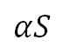
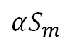
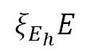
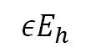
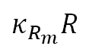
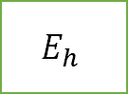
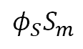
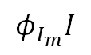
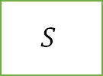
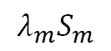
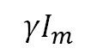

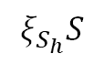
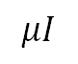
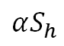
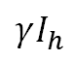
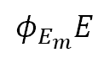
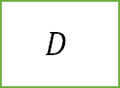
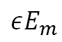
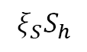
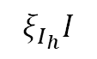
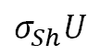
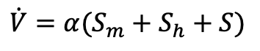
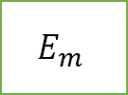
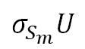
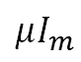
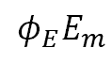

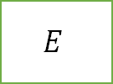
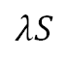
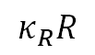
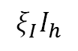
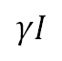
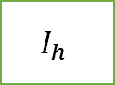
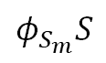
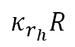
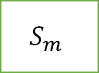
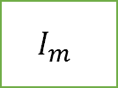
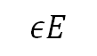
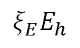
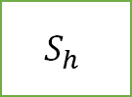
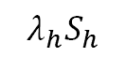
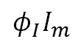
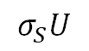
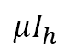

$$κ_{r_{h}}R$$
$$S_{h}$$
$$λ_{h}S_{h}$$
$$E_{h}$$
$$εE_{h}$$
$$I_{h}$$
$$σ_{Sh}U$$
$$ξ_{S}S_{h}$$
$$ξ_{E}E_{h}$$
$$μI_{h}$$
$$ξ_{E_{h}}E$$
$$ξ_{I_{h}}I$$
$$ξ_{I}I_{h}$$
$$ξ_{S_{h}}S$$
$$κ_{R}R$$
$$αS_{h}$$
$$γI_{h}$$
$$σ_{S}U$$
$$λS$$
$$εE$$
$$U$$
$$S$$
$$E$$
$$I$$
$$μI$$
$$αS$$
$$D$$
$$γI$$
$$φ_{S}S_{m}$$
$$φ_{S_{m}}S$$
$$φ_{E}E_{m}$$
$$φ_{E_{m}}E$$
$$φ_{I}I_{m}$$
$$φ_{I_{m}}I$$
$$σ_{S_{m}}U$$
$$αS_{m}$$
$$R$$
$$μI_{m}$$
$$S_{m}$$
$$E_{m}$$
$$I_{m}$$
$$γI_{m}$$
$$λ_{m}S_{m}$$
$$εE_{m}$$
$$\dot{V}=α(S_{m}+S_{h}+S)$$
$$κ_{R_{m}}R$$

Slide 2
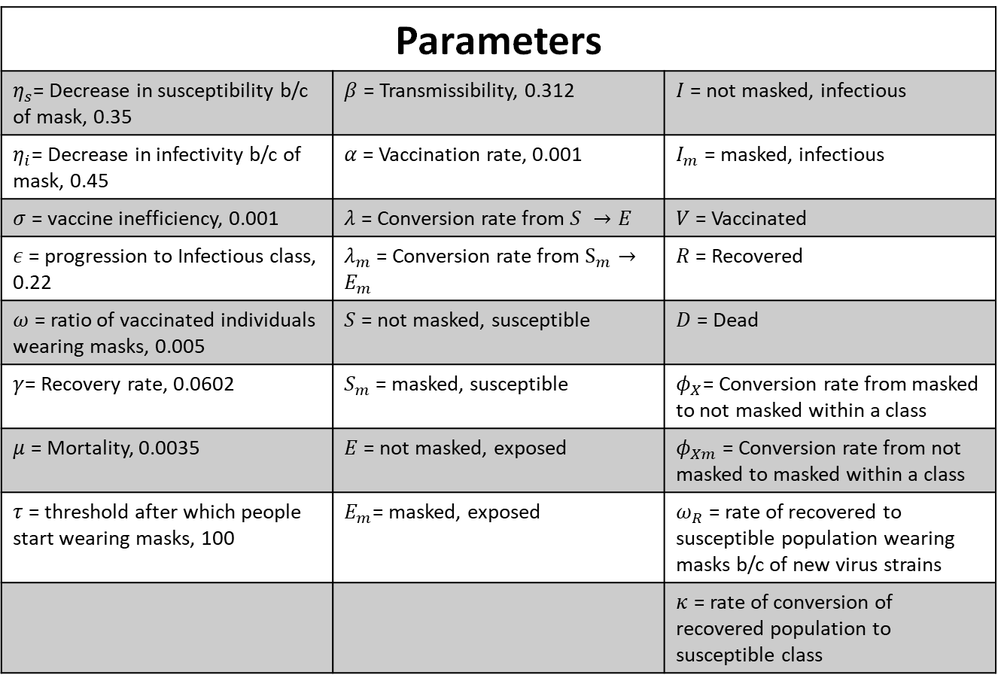
Parameter values from paper
Parameters
$η_{s}$= Decrease in susceptibility b/c of mask, 0.35 | $β$ = Transmissibility, 0.312 | $I$ = not masked, infectious
$η_{i}$= Decrease in infectivity b/c of mask, 0.45 | $α$ = Vaccination rate, 0.001 | $I_{m}$ = masked, infectious
$σ$ = vaccine inefficiency, 0.001 | $λ$ = Conversion rate from $S →E$ | $V$ = Vaccinated
$ε$ = progression to Infectious class, 0.22 | $λ_{m}$ = Conversion rate from $S_{m}→E_{m}$ | $R$ = Recovered
$ω$ = ratio of vaccinated individuals wearing masks, 0.005 | $S$ = not masked, susceptible | $D$ = Dead
$γ$= Recovery rate, 0.0602 | $S_{m}$ = masked, susceptible | $φ_{X}$= Conversion rate from masked to not masked within a class
$μ$ = Mortality, 0.0035 | $E$ = not masked, exposed | $φ_{Xm}$ = Conversion rate from not masked to masked within a class
$τ$ = threshold after which people start wearing masks, 100 | $E_{m}$= masked, exposed | $ω_{R}$ = rate of recovered to susceptible population wearing masks b/c of new virus strains
 |  | $κ$ = rate of conversion of recovered population to susceptible class

Slide 3
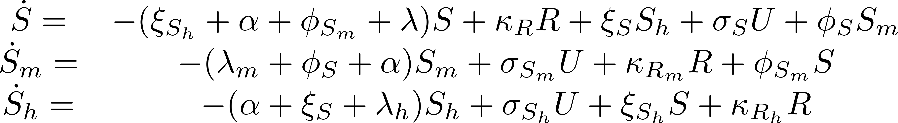
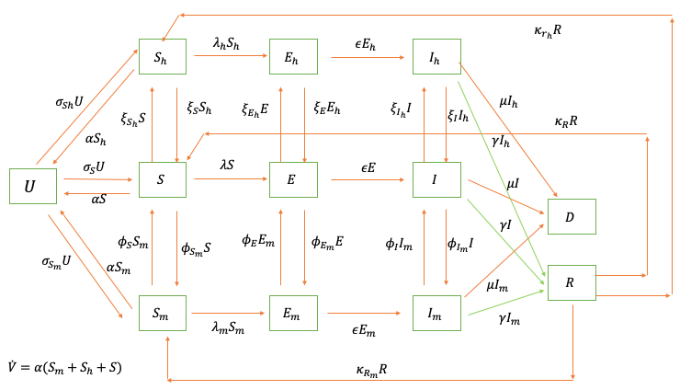
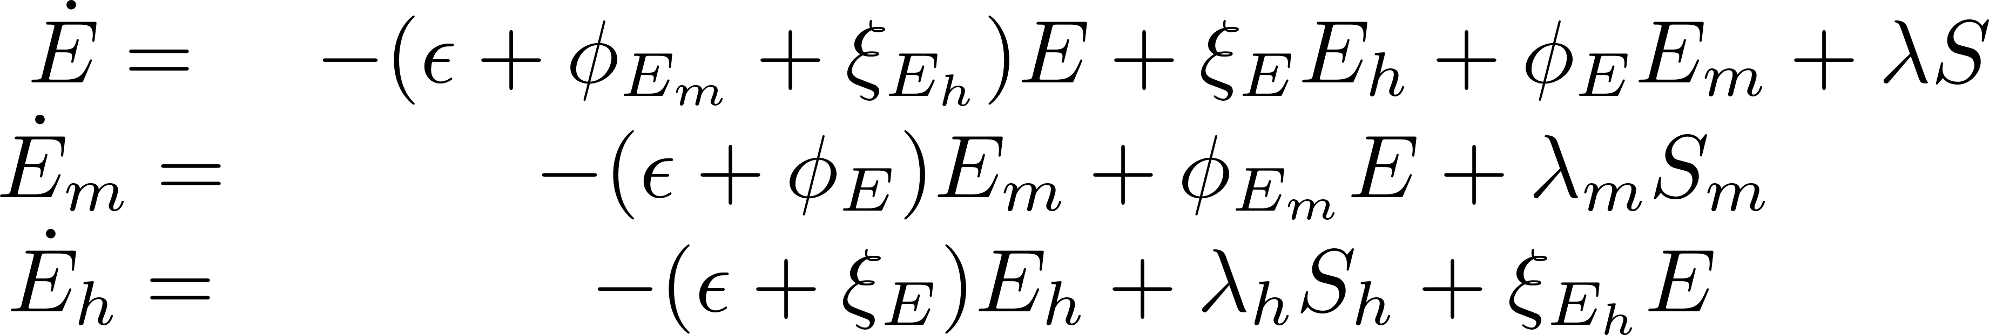
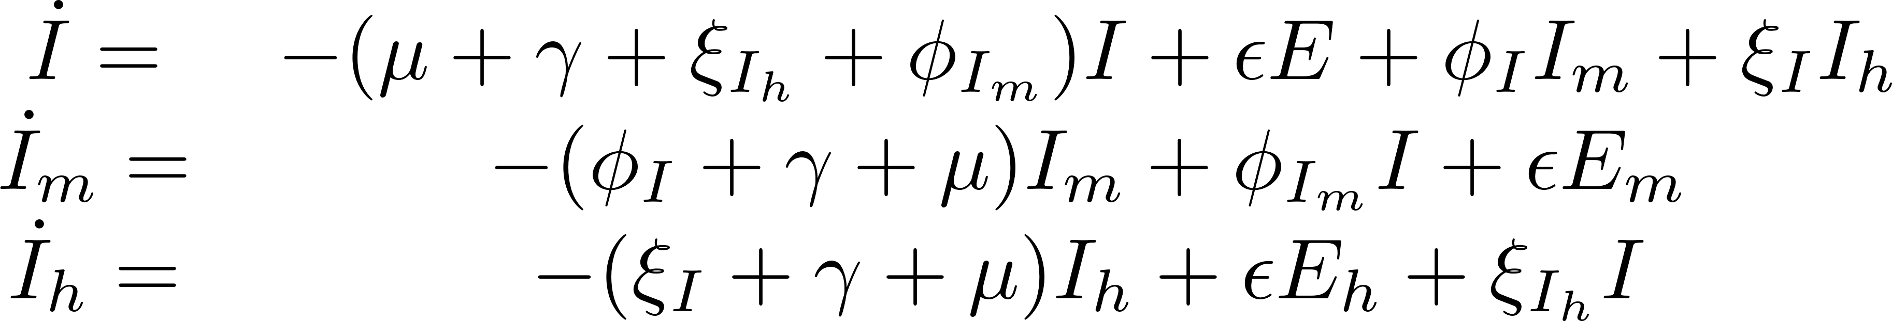
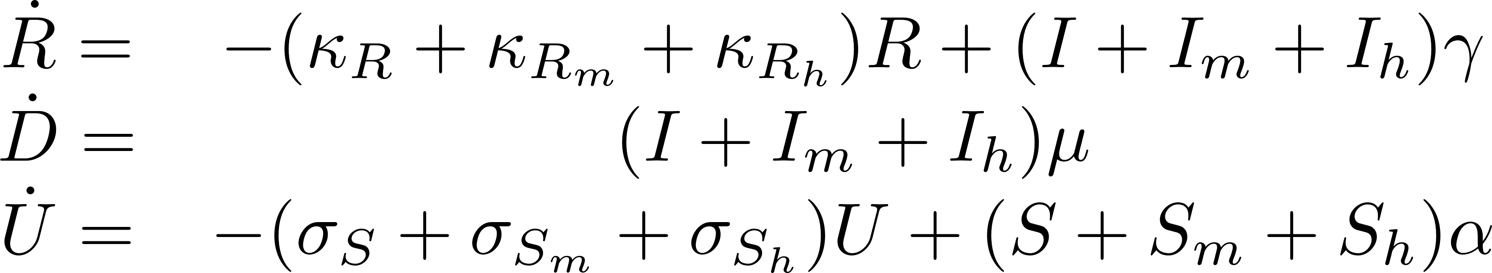
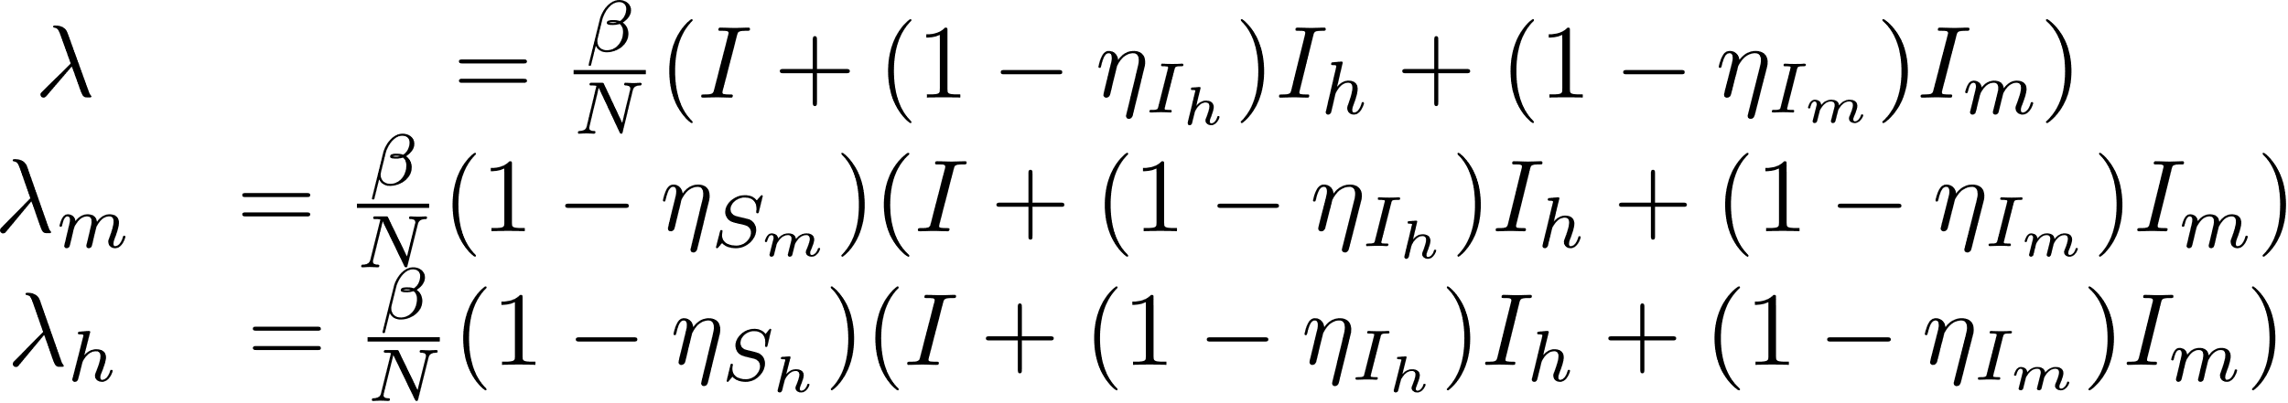




- Tune able Parameters

Slide 4













Objective function
$$O=w_{D}\sqrt{\sum_{t}{{\left(\hat{D\left(t\right)}−D\left(t\right)\right)}^{2}}}+w_{I}\sqrt{\sum_{t}{{\left(\hat{I\left(t\right)}−I\left(t\right)\right)}^{2}}}{+ w}_{U}\sqrt{\sum_{t}{{\left(\hat{V\left(t\right)}−V(t)\right)}^{2}}}{+ w}_{H}\sqrt{\sum_{t}{{\left(\hat{H\left(t\right)}−H\left(t\right)\right)}^{2}}}{+ w}_{M}\sqrt{\sum_{t}{{\left(\hat{M\left(t\right)}−M\left(t\right)\right)}^{2}}}$$
$$V\left(t\right)= \sum_{τ=0}^{t}{U(t)}$$
$$w_{D}=0.35, w_{I}=0.1, w_{U}=0.35, w_{H}=0.1,w_{M}=0.1$$
$$H={−(S}_{h}+E_{h}+I_{h})/(S_{h}+E_{h}+I_{h}+S_{m}+E_{m}+I_{m}+S+E+I+U+D +R)$$
$$M={(S}_{m}+E_{m}+I_{m})/(S_{h}+E_{h}+I_{h}+S_{m}+E_{m}+I_{m}+S+E+I+U+D +R)$$
Initial Conditions
$$S_{0}=9.7E6 −24$$
$$I_{0}=24$$
Other parameters start from 0
$$0.1≤φ_{1},φ_{2},ξ_{1},ξ_{2}≤1$$
$$0.01≤σ_{S}, σ_{S_{m}}, σ_{S_{h}},κ_{R_{h}},κ_{R},κ_{R_{m}}≤1$$
$$0.2≤β≤0.4$$
$$0.01≤γ≤0.3$$
$$0.001≤μ≤0.01$$
$$0.1≤η_{s_{m}}≤1.0$$
$$0.1≤η_{I_{m}}≤1.0$$
$$0.1≤ε≤1.0$$
$$0.1≤η_{S_{h}}≤1.0$$
$$0.1≤η_{I_{h}}≤1.0$$

Slide 5

UKF variable estimations

Slide 6

UKF parameter estimations

Slide 7

UKF SEI individual compartments

Slide 8

SEI mean plots with standard deviation

Slide 9


Slide 10

TEs on different infection routes

Slide 12


Slide 13
Appendix

Slide 14


Slide 15


Slide 16


Slide 17



Parameters within limits as described in previous slides
$$Initial$$
$$Δ$$
omicron

Slide 18


Slide 19


Slide 20


Slide 21





- Tune able Parameters

Slide 22






Objective function
$$O=w_{D}\sqrt{\sum_{t}{{\left(\hat{D\left(t\right)}−D\left(t\right)\right)}^{2}}}+w_{I}\sqrt{\sum_{t}{{\left(\hat{I\left(t\right)}−I\left(t\right)\right)}^{2}}}{+ w}_{U}\sqrt{\sum_{t}{{\left(\hat{V\left(t\right)}−V(t)\right)}^{2}}}{+ w}_{H}\sqrt{\sum_{t}{{\left(\hat{H\left(t\right)}−H\left(t\right)\right)}^{2}}}{+ w}_{M}\sqrt{\sum_{t}{{\left(\hat{M\left(t\right)}−M\left(t\right)\right)}^{2}}}$$
$$V\left(t\right)= \sum_{τ=0}^{t}{U(t)}$$
$$w_{D}=0.35, w_{I}=0.1, w_{U}=0.35, w_{H}=0.1,w_{M}=0.1$$
$$H={−(S}_{h}+E_{h}+I_{h})/(S_{h}+E_{h}+I_{h}+S_{m}+E_{m}+I_{m}+S+E+I+U+D +R)$$
$$M={(S}_{m}+E_{m}+I_{m})/(S_{h}+E_{h}+I_{h}+S_{m}+E_{m}+I_{m}+S+E+I+U+D +R)$$
Initial Conditions
$$S_{0}=9.7E6 −24$$
$$I_{0}=24$$
Other parameters start from 0
$$0.01≤ ω_{1}, ω_{2}, θ_{1}, θ_{2},ζ_{1}, ζ_{2}, a_{1},a_{2},b_{1},b_{2}≤10$$
$$0.01≤σ_{S_{max}}, σ_{{S_{m}}_{max}}, σ_{S_{h_{max}}}, c, η_{i}≤1$$
$$300≤t_{0}≤1000$$
$$0.2≤β≤0.4$$
$$0.01≤γ≤0.3$$
$$0.001≤μ≤0.01$$
$$0.01≤η_{s_{m}}≤1.0$$
$$0.01≤η_{I_{m}}≤1.0$$
$$0.1≤ε≤0.3$$
$$0.01≤η_{S_{h}}≤1.0$$
$$0.01≤η_{I_{h}}≤1.0$$

Slide 23


Slide 24

Dry-Run with new weights

Slide 25

Death Fit

Slide 26

Vaccination fit

Slide 27

Death and Vaccination Fit

Slide 28

Multiple Fit

Slide 29

Multiple Fit

Slide 30

Multiple Fit

Slide 31

Fit
Fit with 1000 days

Slide 32

Piecewise
\kappa -2
\beta -3
\mu – 3
t1 of beta 1 is same as t1 of mu1
Lower limits of t-s to new variants
Try different objective functions including max and weighted and pareto etc.

Slide 33

Multiple Fit

Slide 34

Infectious Fit

Slide 35


